Slide 1
Phase I Final Presentation:
Safety Analysis For Evaluating (SAFE) sUAS
NASA SBIR Contract Number: NNX16CL88P
Presented to: Rania Ghatas, NASA LaRC
IAI | Ankit Tyagi (PI) Sri Ayyalasomayajula Nikhil Nigam Fred Wieland
Purdue | Prof. Inseok Hwang Chiyu Zhang
December 02, 2016

Slide 2
Presentation Outline
Schedule
Problem Description
Phase I Tasks
Phase I Highlights
Detailed Technical Discussion
Phase II Plans
Questions/Action Items and Wrap Up

Slide 3
Project Schedule
06/10
07/10
08/10
09/10
10/10
11/10
12/10
Tasks\Months | 1 | 2 | 3 | 4 | 5 | 6
Task 1
Task 2
Task 3
Task 4
Task 5
Task 6
Task 7
Today

Slide 4
PROBLEM DESCRIPTION
What is the problem? How will SAFE sUAS help?

Slide 5
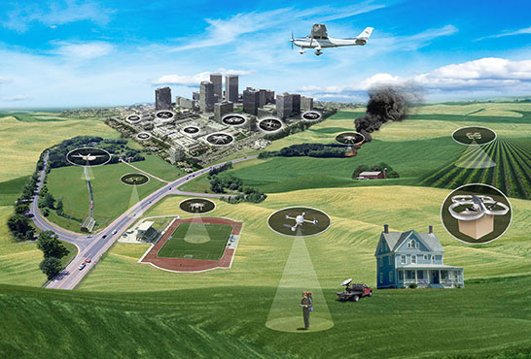
Problem and Proposed Solution
No standard safety tool for sUASs exists today
Safety procedures for sUAS will require ability to simulate sUAS trajectories with high level of precision
SAFE sUAS Approach
Develop medium fidelity sUAS trajectory model informed by high fidelity simulations and flight test for variety of sUASs
Use these models as inputs to existing UAS safety models
Small UAS in the NAS OV1 (UTM Project)
“Currently, there is no established infrastructure to enable and safely manage the widespread use of low-altitude airspace and UAS operations, regardless of the type of UAS”
Ref: https://utm.arc.nasa.gov/index.shtml

Slide 6
Phase I Work Plan
Task 1: Hold kickoff meeting and establish program requirements
Task 2: Setup 6-DOF flight dynamics and control simulation
Task 3: Use 6-DOF closed-loop flight simulation for generation of sUAS performance files
Task 4: Modify KTG for sUAS trajectory generation using performance files from Task 3
Task 5: Validate modified-KTG trajectories against 6-DOF simulation
Task 6: Demonstrate prototype simulation analysis results for sUAS
Task 7: Develop concepts for Phase II and transition
Additional Tasks Executed
High fidelity battery drain modeling
Hardware in the loop testing for battery drain rate

Slide 7
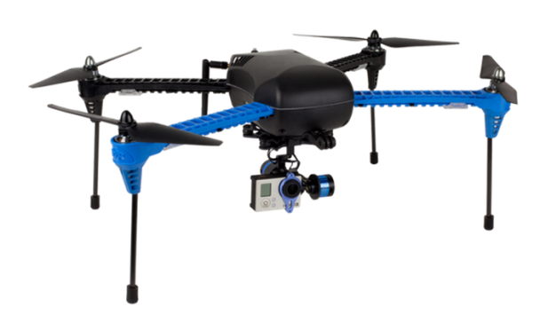


Phase I Highlights
Developed a scalable sUAS trajectory modeling architecture that allows for integrating high fidelity performance data with medium fidelity trajectory models
Developed trajectory generator for rotorcraft sUAS and validated the results using high fidelity 6-DOF simulations
Developed high fidelity battery drain rate model validated by hardware in the loop tests
Performed preliminary safety analysis for package delivery and aerial imaging missions using sUAS

Slide 8
Technical Overview

Slide 9
sUAS Trajectory Generator (sUTG) Overview
UAS Flight Demand
Flight plan-like information for each sUAS flight
Sample flight plans were developed for this briefing
Rotorcraft Performance Database (RPD)
Aircraft performance under different mission segment and altitude combinations
sUAS Trajectory Generator (sUTG)
3 DOF trajectory model that computes flight trajectories at 500 millisecond interval

Slide 10
RPD Development
6-DOF Model
Quadcopter model developed to mimic IRIS implemented in jMAVSim
6-DOF Mission Simulations
Refinement Loop: To develop the 6-DOF model
Production Loop: To populate RPD

Slide 11

SAFE sUAS Workflow
Kinematic Trajectory Generator
sUTG
Testbed
Safety
Analyses
Rotorcraft Performance Database Requirements
Rotorcraft Performance Database
sUTG and Performance
Database Refinement Loop
Validated
6-DOF Model
Quadcopter Design
6-DOF Model
sUAS Simulations | HIL | Flight Tests*
Refinement Loop
*Phase II Plans

Slide 12
Detailed technical discussion
Development of sUTG and use of RPD

Slide 13
sUTG Architecture
The architecture is similar to Kinematic Trajectory Generator
Well known, industry vetted, trajectory model for fixed wing large aircraft
Uses EUROCONTOL’s BADA file for performance computations
sUTG comprises of three main modules:
Navigation Control Module
Computes desired speed, heading and ROCD
Low level control
Computes desired acceleration and turn rate
Plant
Uses equations of motion to update sUAS state
Goal: Use as much of KTG’s algorithms as possible to develop sUTG
Result:
sUTG = KTG for quadcopter sUAS

Slide 14
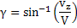
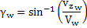
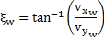
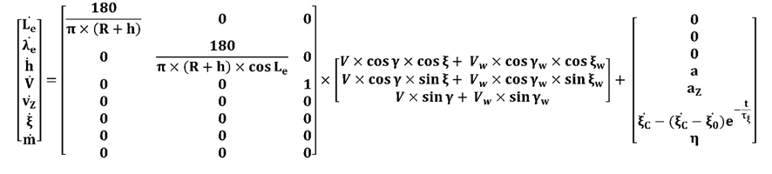
sUTG: Equations of Motion
KTG is a 3-DOF model and therefore allows us to re-use much of the existing modules to simulate small quadcopter flights
States
Latitude ( L_{e})
Longitude (λ_{e})
Altitude (h)
TAS (V)
Vertical speed (v_{z})
Heading (ξ)
Mass (m)
Existing equations of motion modeled in KTG
Control Inputs
Longitudinal acceleration (a)
Vertical acceleration (a_{z})
Commanded turn rate ( )
Fuel consumption rate (η)
where,
V_{w}: wind speed

Slide 15
sUTG: Low Level Controller
The Low level controller calculates:
Acceleration in longitudinal direction
Acceleration in vertical direction
Turn rate
The low level controller required the following modifications to account for the sUAS performance limitations:
PI controller associated with each control loop
Re-tuned gains for sUAS
Saturator limits accelerations and turn rate
Defined appropriate limits for sUAS
Saturator limits speeds
Defined appropriate limits for sUAS

Slide 16
Rotorcraft Performance Database
RPD serves as lookup table for the 3-DOF sUAS Trajectory Generator (sUTG) model and is populated by operating the 6-DOF model (from Purdue) over a set of procedures.
The structure and use is inspired by EUROCONTROL’s Base of Aircraft Data (BADA) files
RPD specify cruise, climb, descent, and hover performance at different flight levels, throttle settings and other aircraft state parameters. More flight modes can be added in the future.

Slide 17
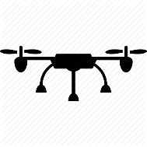

Use of RPD

Slide 18
Detailed technical discussion
Development of 6-DOF Model and RPD

Slide 19
Overview
6-DOF flight dynamics modeling and simulation platform development for RPD creation and validation of sUTG
6-DOF high-fidelity dynamics modeling
6-DOF modeling parameters
Software interface
Simulation platform development
Hardware in-the-loop (HIL) simulation setup
Integrate battery drain database
HIL Simulation
Generate the Rotorcraft Performance Database (RPD)

Slide 20

Overview
VTOL sUAS Considered
Name | IRIS+
Vendor | 3D Robotics
Type | VTOL
Weight (lbs.) | 3
Endurance (min.) | 16-22
Number of motors | 4

Slide 21
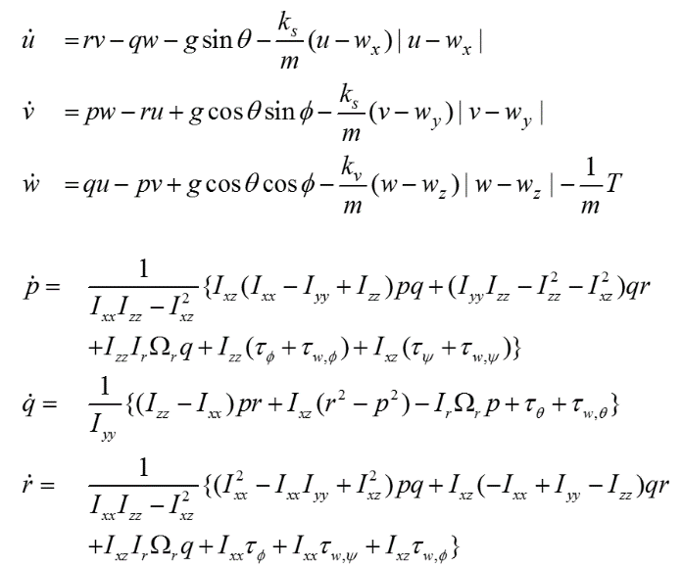
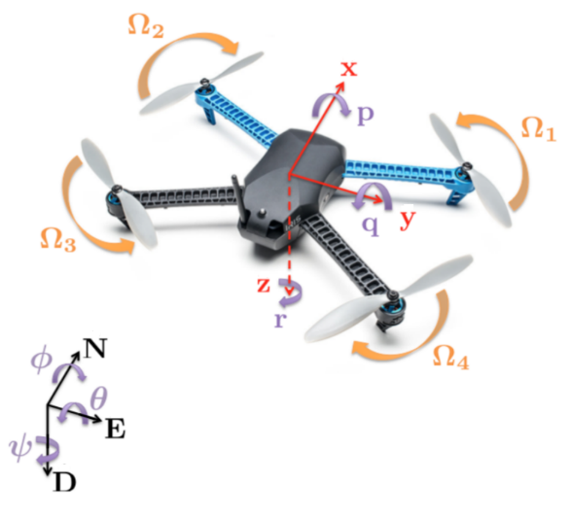
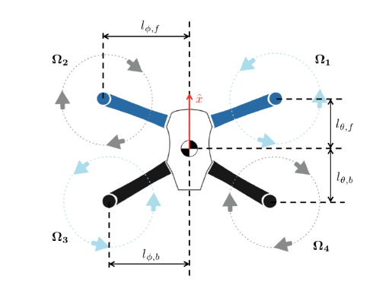
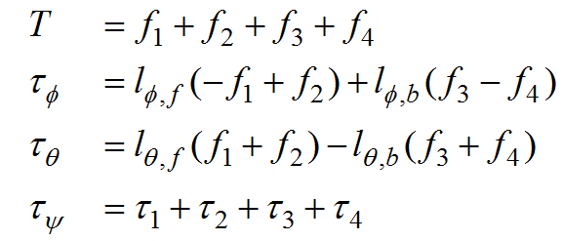
6-DOF Quadcopter Dynamics
6-DOF Equations of Motion:
Thrust and Torque Equations:
IRIS+ coordinate frames
Top view of IRIS+

Slide 22
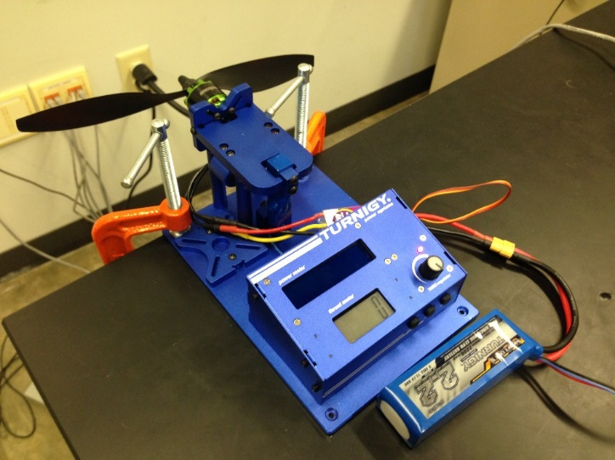
6-DOF Quadcopter Modeling
Modeling parameters:
System parameters
Mass
Moments of inertia
Positions of the rotors
Maximum rotor thrust and torque
Propeller aerodynamic coefficients
Obtaining parameter values
mass, moments of inertia, and thrust arms: by measurement
thrust and rotor drag factors: from manual
maximum thrust and torque: by experiment
the maximum thrust is obtained from experiment
the maximum torque is calculated from the test output
Rotor Testbed

Slide 23
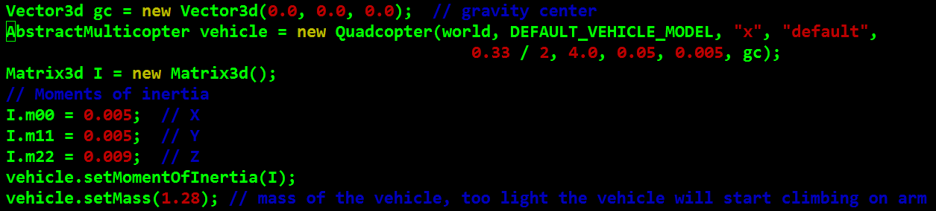
6-DOF Model Software Interface
jMAVSim flight simulator (open source)
Multi-rotor dynamics simulator
Suitable for both hardware- and software-in-the-loop purposes
Builds customized quadcopter models from user-defined parameters
6-DOF Modeling
Set the modeling parameters in the source code
A user manual is developed to provide the details

Slide 24
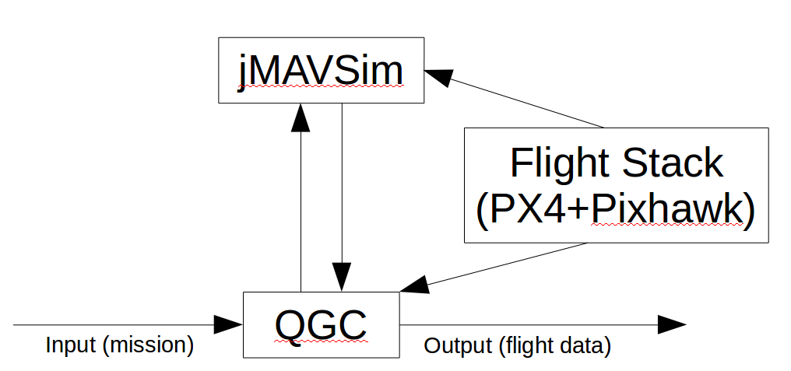
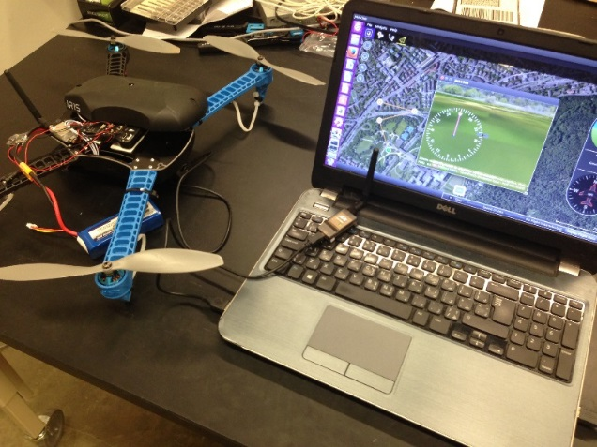
Simulation Platform
HIL Simulation Components (All open source):
jMAVSim: dynamic simulator
Qgroundcontrol (QGC): ground control station
PX4: autopilot software
Pixhawk: autopilot hardware
Pixhawk
QGC
jMAVSim

Slide 25
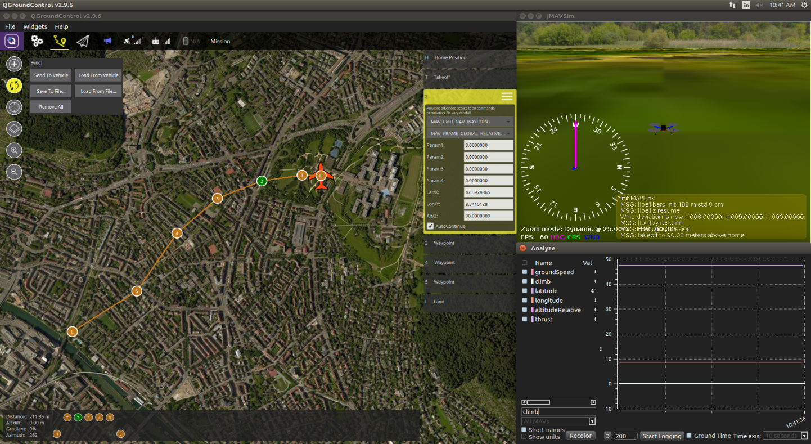
Simulation Inputs/Outputs
Inputs: waypoints by mouse clicking/input files/user interface
quadcopter’s status: e.g. takeoff, landing, etc.
coordinate: latitude, longitude, alt
for quadcopters: hovering time
Outputs: data files containing variable names and values
a list of over 120 variables including: speed, attitude, position, etc.
select the desired output from the list
Mission planning (waypoints)
Select the outputs
right figure: operation window
Notes:
id: the quadcopter will first move to WP 1, and then to WP 2, and so on;
param2: that if the sphere with this radius is hit by the quadcopter, the WP counts as reached;
param3: set to 0 if the quadcopter is desired to pass through the WP; otherwise this parameter controls the radius to fly by the WP, where a positive value for a clockwise orbit and a negative value for a counter-clockwise orbit;

Slide 26
Battery Drain Rate Modeling
Motivation:
The battery drain rate (mAh/s) changes during flight
Analogy with ‘fuel consumption’
Essential for performance and safety analysis
Objective:
Integrate a battery drain rate database
Challenge: NO battery models available among the quadcopter community
Proposed approach: battery test
Test the battery performance at different battery/thrust levels
Build a lookup table of battery drain rate
Find the corresponding battery drain rate according to simulation output

Slide 27
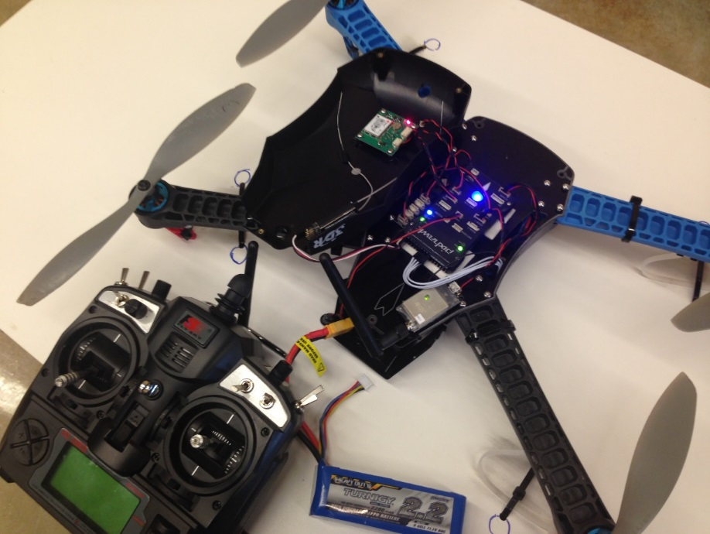
Battery Modeling
Test setup:
Fix the quadcopter to a heavy plate to prevent flight
Use a remote radio controller to control thrust
Record the thrust output and battery info in QGC
Battery specs:
capacity = 2200mAh
voltage = 11.1V
Thrust controller
Quadcopter fixed here
Battery

Slide 28
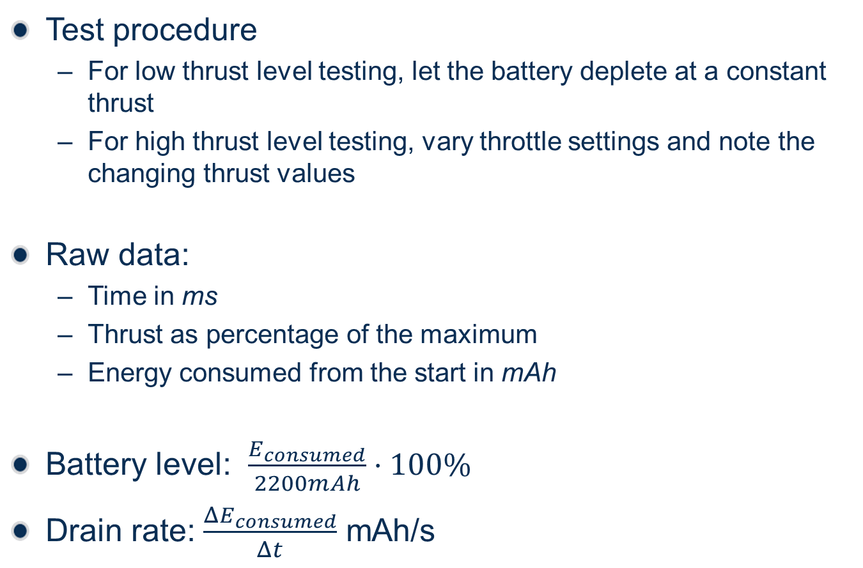
Battery Modeling
Test procedure
For low thrust level testing, let the battery deplete at a constant thrust
For high thrust level testing, vary throttle settings and note the changing thrust values
Raw data:
Time in ms
Thrust as percentage of the maximum
Energy consumed from the start in mAh
Battery level: $\frac{E_{consumed}}{2200mAh}⋅100\%$
Drain rate: $\frac{ΔE_{consumed}}{Δt}$ mAh/s

Slide 29
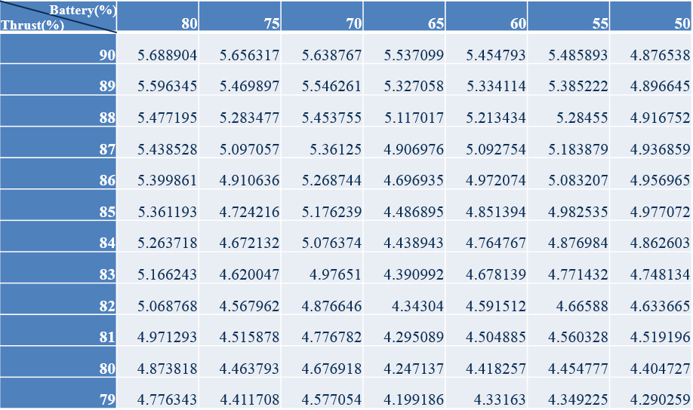
Battery Modeling
Drain rate table
Battery level: 40%~80%, at steps of 5%
40% battery: safety threshold from experiment
80% battery: nominal battery level
Thrust level: 55%~90%, at steps of 1%
55% thrust: hover thrust
90% thrust: safety upper bound in autopilot
table entry: drain rate (mAh/s)
Table shows battery drain rate under combinations of battery level and thrust levels

Slide 30
Rotorcraft Performance Database (RPD)
RPD file
Performance data at nominal (80%) and critical (40%) battery levels
Four basic flight modes: cruise, climb, descend, and hover
Create simulation scenarios corresponding to the flight modes
Simulation output: groundspeed, altitude, climb rate, thrust
Use the thrust output to find the corresponding battery drain rate from the drain rate table
Use the data to populate RPD table
Flight mode | Simulation scenario
Cruise | Cruise at nominal speed at a given altitude
Climb | Takeoff to 400 ft. AGL
Descend | Land from 400 ft. AGL
Hover | Hover at a given altitude

Slide 31
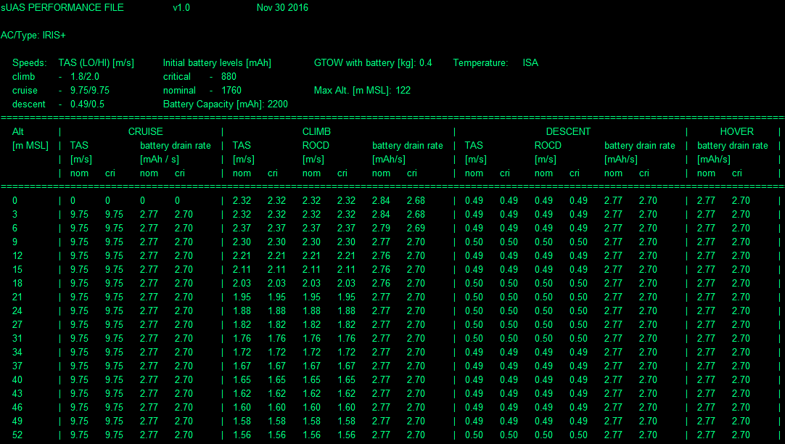
sUAS Performance Data for IRIS (.RPD)
Speed limits for flight modes
Baseline levels of battery
TAS at different flight levels and battery conditions
Battery drain rate for a given flight mode, battery level, altitude and TAS

Slide 32
Validation
Compare sUTG with 6-DOF model for conformance

Slide 33
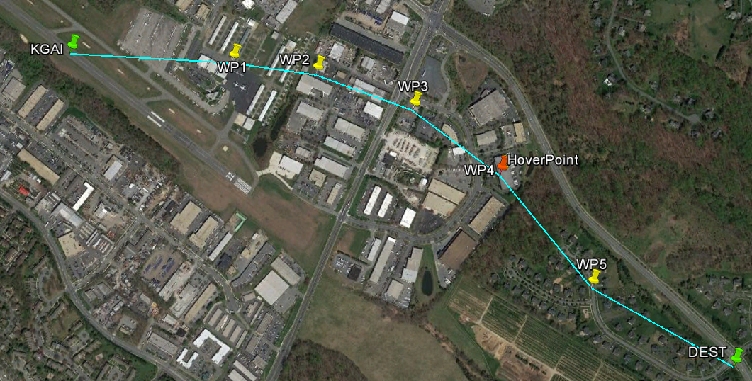
Flight Simulation 1 (High Cruise)
Flight plan
Origin: KGAI (Montgomery County Airpark, Gaithersburg, MD → NW of DC)
Destination: about 1.7 km to southeast of KGAI
Cruise altitude: 300 ft. AGL
Aircraft: IRIS
Cruise speed: 6.7 m/s
Flight duration: ~9 min.
Hover:
Altitude: 300 ft. AGL
Duration: 3 min.

Slide 34
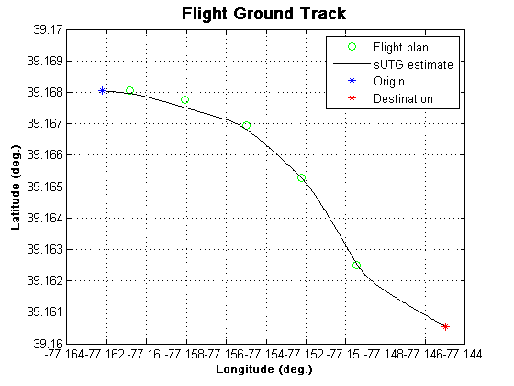
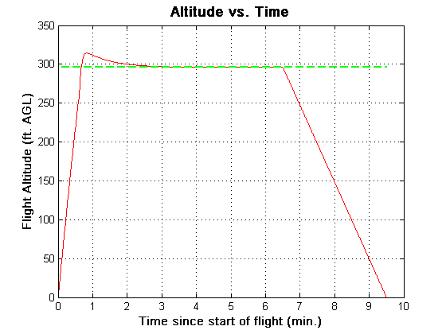
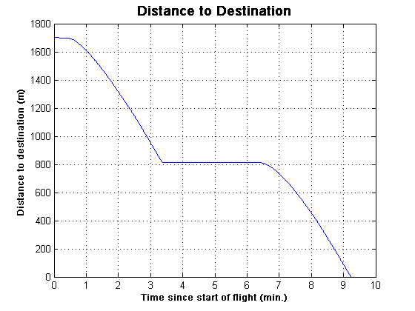
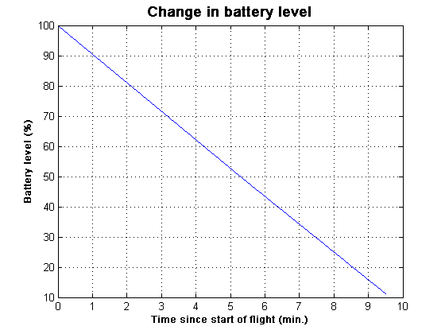
Results
TO
CR
HV
CR
DS/LD
Hover
Distance Vs. Time
Battery Vs. Time

Slide 35
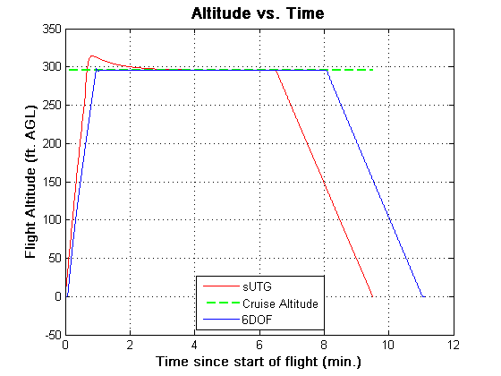
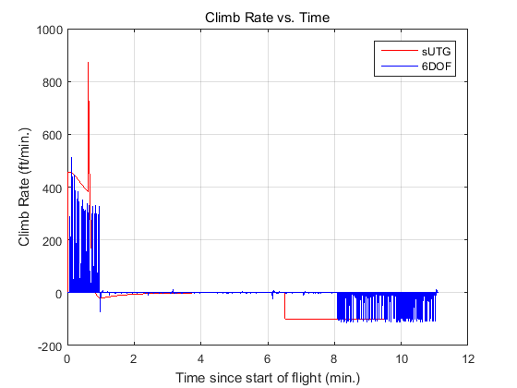
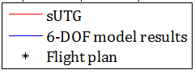
Validation using 6-DOF Model
Latitude (deg.)
Longitude (deg.)
sUTG follows the flight plan well except waypoint 3
sUTG is designed to treat close waypoints as “fly-by” rather than “fly-over”
sUTG initially overshoots the cruise altitude by 25 feet
Result of low level controller gains
Deviation in total flight time is due to “fly-over” waypoint
Some deviations with the climb and descent rate
Good overall conformance over the entire mission

Slide 36
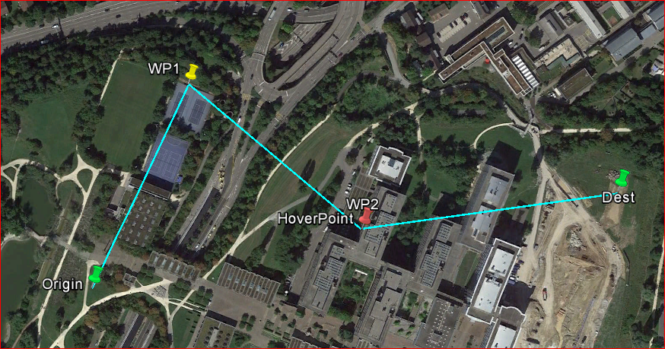
Flight Simulation 2 (Short Flight)
Flight plan
Origin: a generic suburban area
Destination: about 0.5 km to east of origin
Cruise altitude: 80 ft. AGL
Aircraft: IRIS
Cruise speed: 6.7 m/s
Hover:
Duration: 10 seconds
Altitude: 80 ft. AGL
Duration: 3 min.

Slide 37
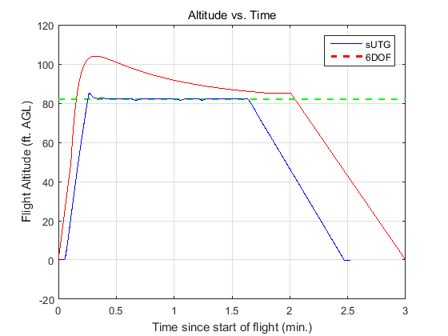
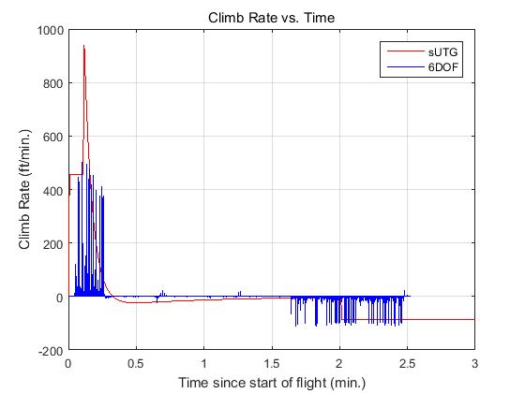
Validation using 6-DOF Model
Latitude (deg.)
Longitude (deg.)
Ground track deviation due to sUTG’s treatment waypoints leading to acute angles as “fly-by” rather than “fly-over”
sUTG initially overshoots the cruise altitude by 25 feet
Result of low level controller gains
Deviation in total flight time is due to “fly-over” waypoint
Some deviations with the climb and descent rate
Good overall conformance over the entire mission
Overall, sUTG shows good conformance with 6-DOF model for both simulations

Slide 38
Safety analyses
Fly two sUAS missions, assess Loss of Separation

Slide 39
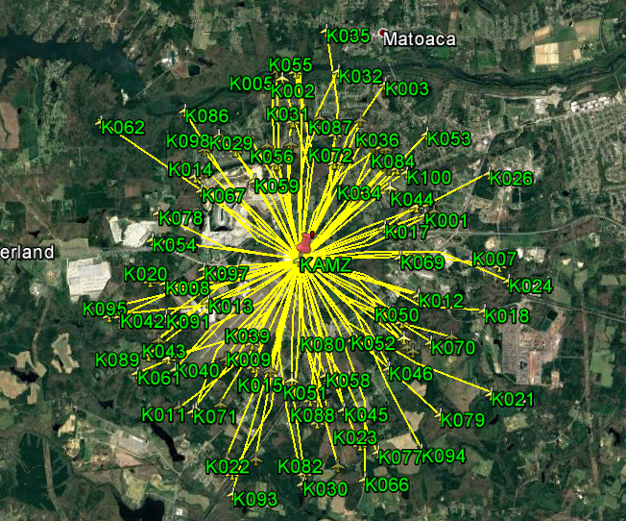
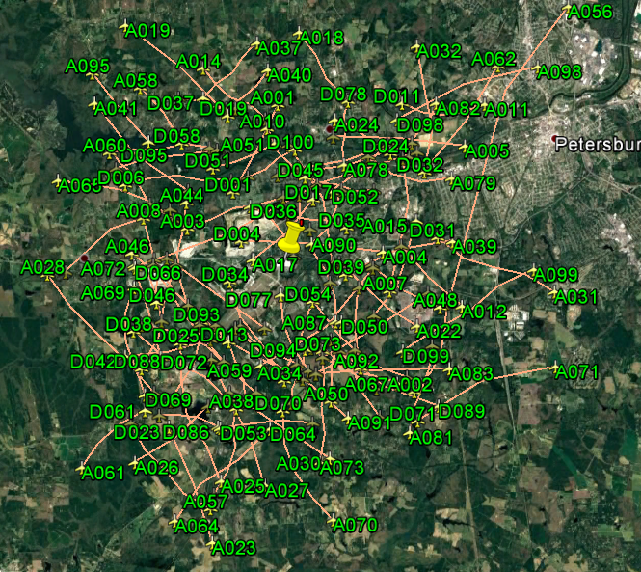
sUAS Simulations

Slide 40



Simulation Setup
100 flights for each application → 200 sUAS flights total
Flights simulated during an 8 hr. window → 9 AM to 5 PM EST
Typical business hours of operation
Safety Metric: Potential loss-of-separation (LOS) events
Assumption: LOS for sUAS is defined as an instance when two sUAS are closer than 50 ft. horizontally or vertically
Total flights | 200
Potential flight pairs | 19,900
Flight pairs airborne at same time | 700
Flight pairs with LOS | 6
LOS location

Slide 41
Lessons Learned
Modeling performance of each aircraft is necessary for any sUAS operations technology
Majority of pilots and even some manufacturers are unaware of performance limits
Critical to model battery drain, the UAS performance is closely tied to battery remaining.
Need battery information for mission planning, contingency management, and performance estimation
Medium fidelity trajectory model informed by high fidelity performance data performs well
Code is efficient enough to simulate large number of aircraft
Results show good conformance with high fidelity model

Slide 42
Phase II Plans
Perform market survey to identify five most popular sUAS and choose five sUAS to model
Ensure at least one fixed wing, rotorcraft and hybrid sUAS is chosen.
Develop performance tables for selected sUAS
Enhance UTG to account for impact of winds and gusts
Enhance UTG to account for sensor uncertainty
Model the impact of non-standard sUAS configurations
Perform flight tests to validate UTG predictions
Develop sUAS missions around expected operations
Analyze the safety impacts of operating sUAS mission on NAS safety

Slide 43
For questions or comments
contact
Ankit Tyagi
Mail: atyagi@i-a-i.com

